Slide 1
www.northmacedonia-timeless.com

Slide 2
The last undiscovered destination in Europe!
Within its small area North Macedonia has a lot to show:
43 Lakes of which 3 tectonic Lakes: Lake Ohrid,
Lake Prespa, Lake Dojran.
Lake Ohrid is one of Europe's deepest and oldest
lakes, declared a World Heritage site by UNESCO
3 National Parks ( Mavrovo, Pelister, Galichica)
16 mountains higher than 2,000 meters ( Highest Peak Golem Korab 2,764 meters)
3+ Waterfalls (higher than 100 m)
Megalithic observatory KOKINO ( 1800 BC.)
There is a lot more, it’s yours to Discover!

Slide 3
HOW TO ARRIVE IN NORTH MACEDONIA
European international road E-75 starts in Finland, drives through Poland, Czech Republic,
Slovakia,
Hungary, Serbia, North Macedonia and ends in Greece
CAR & BUS
International Airport in Skopje is located 21km
from the Skopje’s city center, while the airport in
Ohrid is located 9 km from Ohrid
PLANE

Slide 4
Connections
DESTINATIONS FROM SKOPJE IN MORE THAN 15 COUNTRIES AND 66 DESTINATIONS
ANTALYA, BELGRADE, VIENNA, LJUBLJANA, BASEL, EINDHOVEN, ZAGREB, MALMO,
GOTHENBURG, LONDON, ISTANBUL, IZMIR, DORTMUND, HAMBURG, BRUSSELS, MALTA,
DUBAI, WARSAW, COPENHAGEN, PARIS, ZURICH, FRANKFURT, BERLIN, VAXJO, HANNOVER,
COLOGNE, BRATISLAVA, VENICE, MILAN, ROME, DOHA.

Slide 5
PASSENGERS
2.36M Passengers
2.360.400 passengers landed in Skopje and
Ohrid airports in 2019
AIRLINES
Around 13 Airlines are flying actively:
LOT, Wizzair, Croatia Airlines, Adria Airways, Austrian Airways, Air Serbia, Turkish airlines, Qatar Airways, Edelweiss Air, Pegasus Airline, FlyDubai, Corendon, Sunexpress Airlines
13 Airlines
OVERNIGHTS
3.26M Overnights
According to the State Statistical Office, the number of tourists in 2019 is 1.184.963 and the number of overnights is 3.262.398

Slide 6
Hotels
Rooms
331
17.235
Beds
Restaurants
46.289
4.383

Slide 7
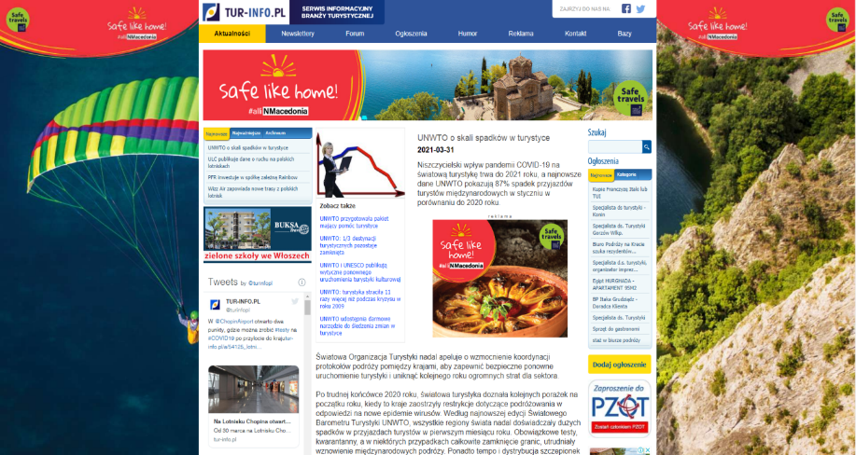
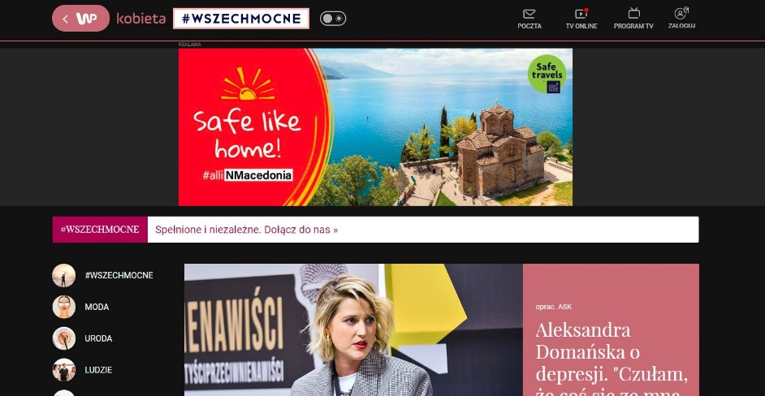
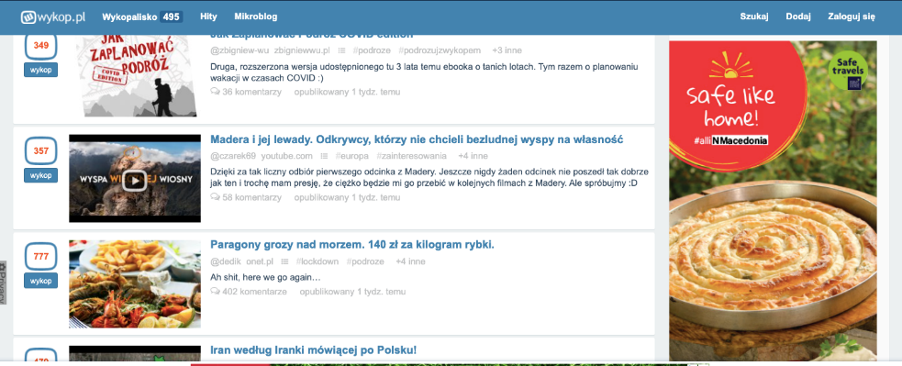
Media campaign POLAND 2021
Tur info
Wirtuelna Polska
Wykop pl

Slide 8
STATISTICS
Overnights 2016
Overnights 2017
Overnights 2018
Overnights 2019
2.461.160
2.775.152
3.176.808
3.262.398
32.6%
overnights
tourists
38.3%
Tourists 2016
Tourists 2017
Tourists 2018
Tourists 2019
856.843
998.841
1.126.935
1.184.963
Graphic display number of domestic and foreign tourists and overnights 2016 - 2019 Source: State Statistical Office

Slide 9
TOP FASTEST GROWING MARKETS 2018/19
0,7 %
2018
3,7 %
6,1 %
40,6 %
2019
3,0 %
Graphic display number of top 5 fastest growing markets Source: State Statistical Office

Slide 10
SUCCESSFUL STORIES

Slide 11
AGENCY FOR PROMOTION AND SUPPORT OF TOURISM
FAM trips
B2B meetings
Media campaigns
Production of video/photo galleries
Brochures, flyers, maps, web sites, mobile apps
Branding and positioning
Walking, biking, hiking trails
Mapping destinations
Mapping hiking trails and attractions
Rock climbing
Event support

Slide 12
www.tourismmacedonia.gov.mk

Slide 14
THANK YOU
AGENCY FOR PROMOTION AND SUPPORT OF TOURISM
OF THE REPUBLIC OF NORTH MACEDONIA
MORE INFO
www.northmacedonia-timeless.com

